Slide 1

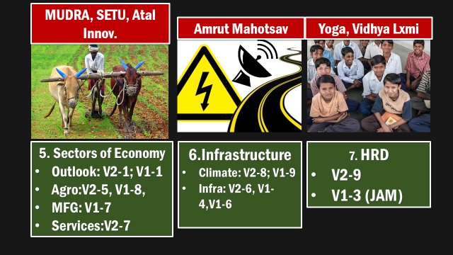
Budget Taxation
14th FC
GST
GDP

Slide 2
GDP: Theory and Current
Formulas
Calculation Methods
CSO modification
Survey Data

Slide 3
GDP Definition
Market value
All final goods & services
Produced within country
For a given time period.

Slide 4
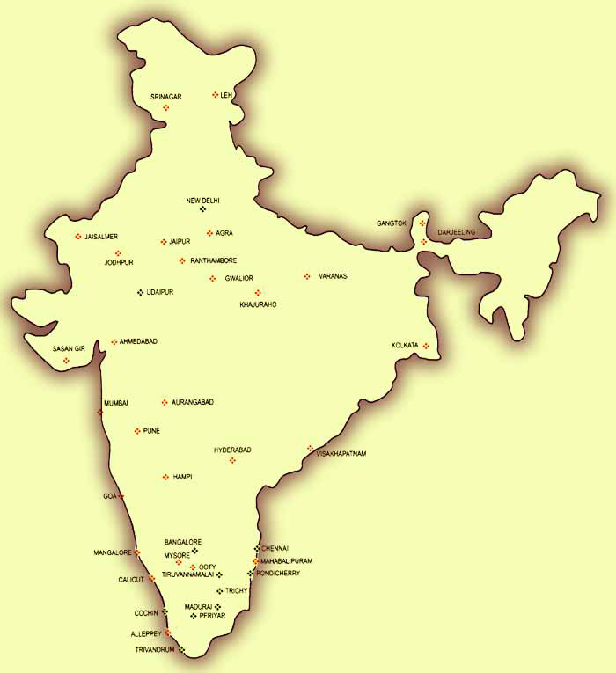



Gross
Domestic
Product
++
++
NA
Tata’s dividend from UK

Slide 5
GDP vs Inflation
Current price
Constant price
GDP deflator

Slide 6
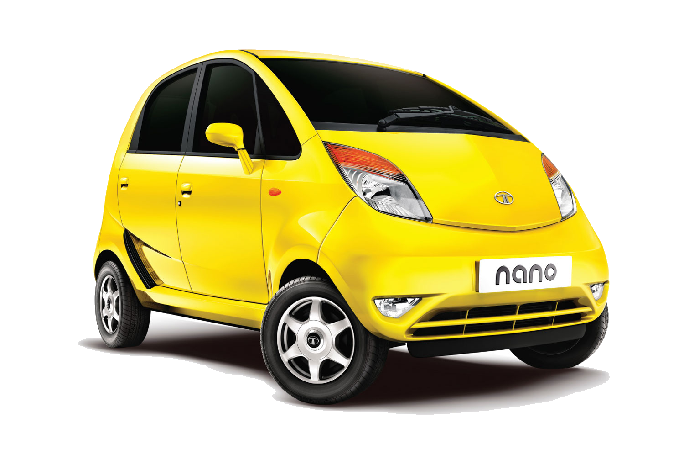
Base year: 2011
Constant Price
Rs.1 Lakh / car
Present year: 2015
Current Price
Rs.1.5 Lakh / car
GDP: 3 lakh
Nominal GDP: 3 lakh

Slide 7
Base year: 2011
Constant Price
Rs.1 Lakh / car
Present year: 2015
Adjust with Base year (Constant) Price
Rs.1.5 lakh 1 Lakh / car
Nominal GDP: 3 lakh
GDP: 3 lakh
Real GDP: 2 lakh

Slide 8
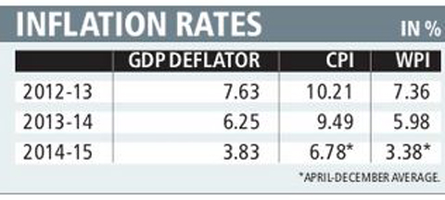
Present year: 2015
Base year (constant) Price
Rs.1 Lakh / car
Nominal GDP: 3 lakh
GDP
Deflator
100
Real GDP: 2 lakh
GDP Deflator=150

Slide 9
Gross National Product
++
MINUS
GNP = GDP + Net Income from abroad
++
Tata’s dividend from UK

Slide 10
Real vs Nominal GDP, GDP deflator
GDP vs. GNP
NEXT: Factor Cost vs Market Price

Slide 11
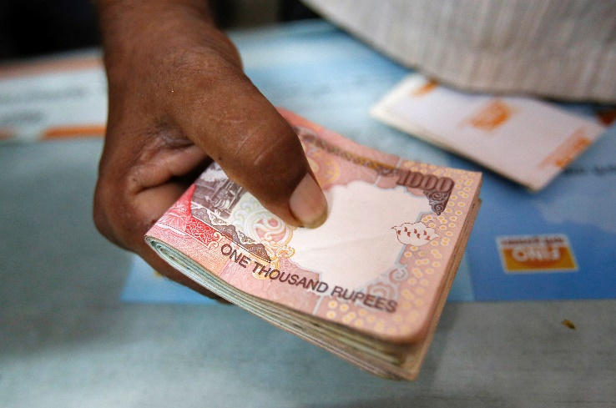
Labor
Land
Capital
Entrepreneurship
Wage(W)
Rent(R)
Interest(I)
Profit(P)
+ Taxes: 20k
- Subsidies: 5k
Factor Cost
Rs.1 Lakh
Market Price: 1.15 L

Slide 12
GDP Market Price
(+) GDP @Factor Cost
(+) Taxes
(-) Subsidies

Slide 13
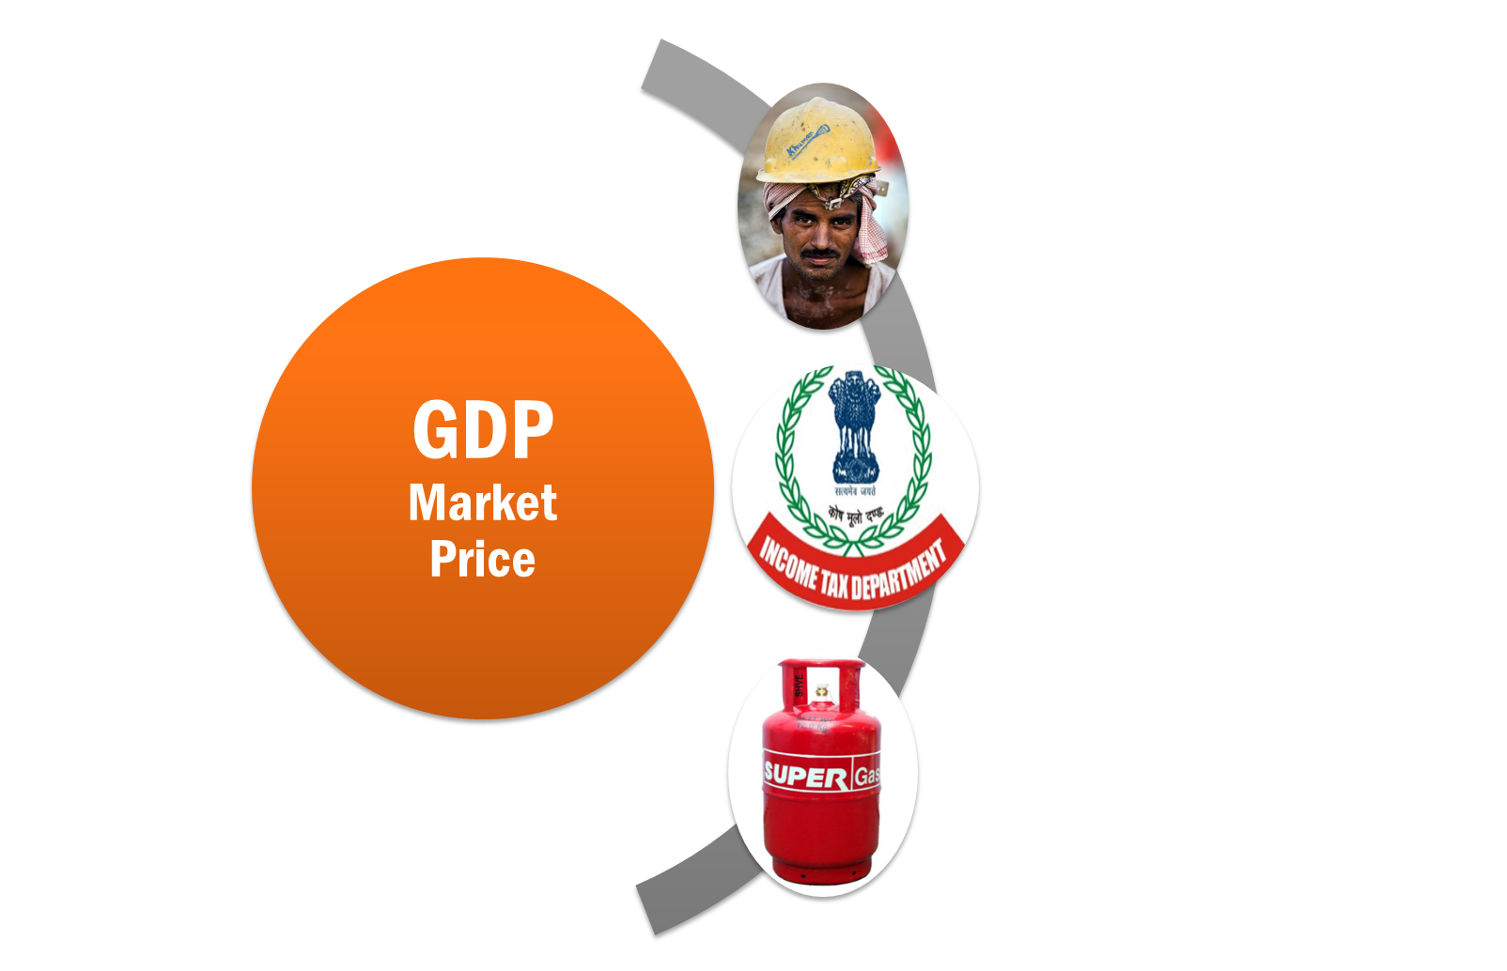
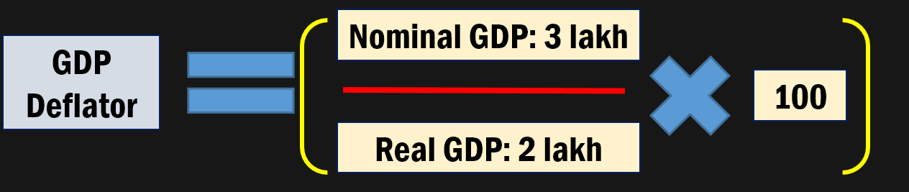
GNP = GDP + Net Income from abroad

Slide 14

NET
National
Product
(Market
Price)
Gross
National
Product
(-) Depreciation
NNP
(MP)
-TAX
+Subsidies
NNP(FC)
=National
income

Slide 15
GDP Market Price
(+) GDP @Factor Cost
(+) Taxes
(-) Subsidies

Slide 16
NNP Market Price
(+) NNP @Factor Cost
(+) Taxes
(-) Subsidies

Slide 17
What is Net National Income? (1997)
Net Domestic Product at market price
Net Domestic Product at factor cost
NNP at market price
NNP at factor cost (right, NCERT Class12, Macro, Page24)
1. Skip 2. Attempt 3. Mark n Review

Slide 18
Per capita National Income (Current Market Price)

Slide 19
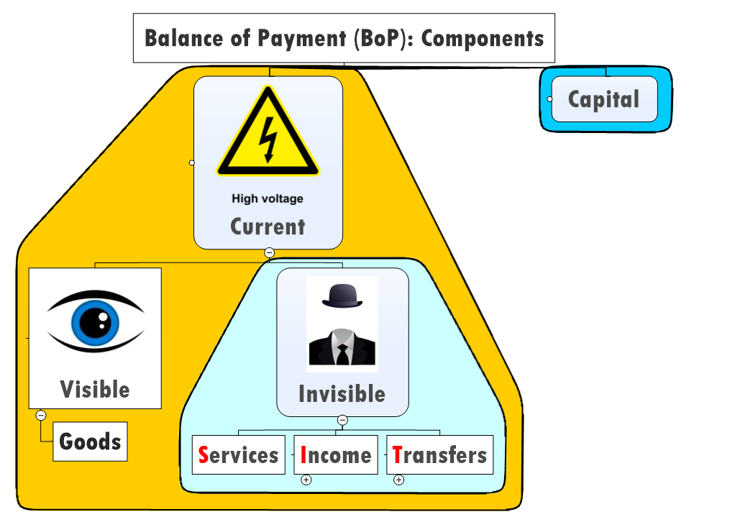
GNP
Depreciation
NNP (MP)
Current Transfer
National
Disposable
income

Slide 20
NCERT
Class 12 macro-economics
Chapter 2
+ glossary / appendix

Slide 21
So far
Formulas
Calculation Methods
CSO modification
Survey Data

Slide 22
GDP Calculation
3 methods
Income
Expenditure
Production (GVA)

Slide 23
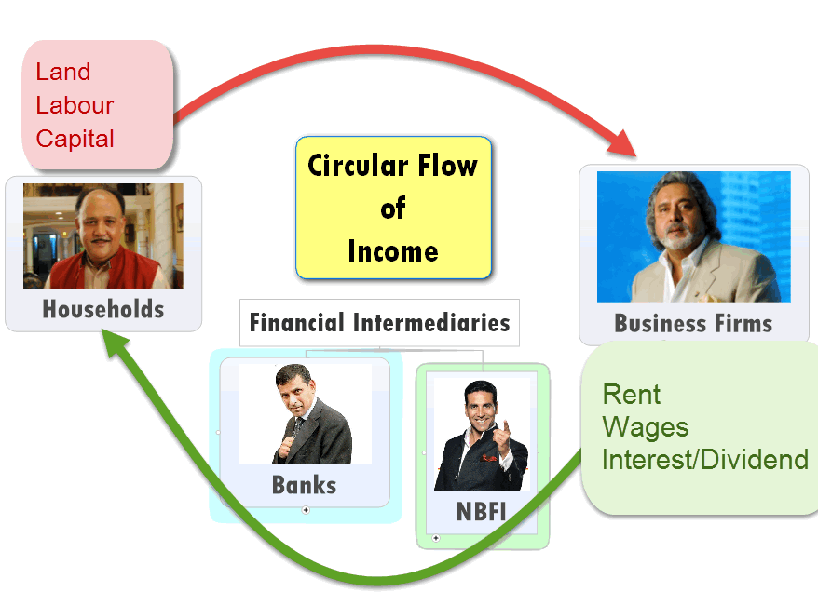
Method #1: Income

Slide 24
Factor
Income
Wages
Interest
Land/Building
Profit
Rent
Entrepreneur
Labor
Capital
Total= GDP @Factor Cost

Slide 25
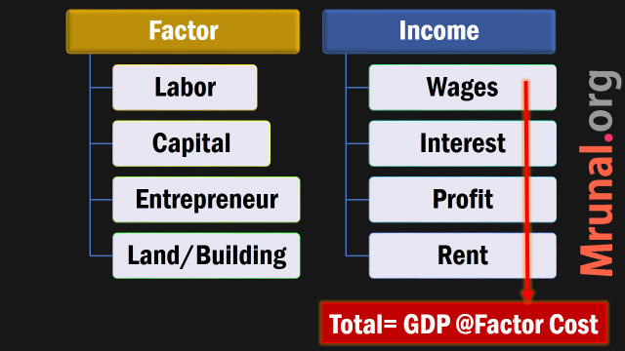

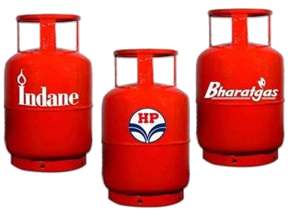
GDP Constant
@ market prices
Inflation adjust
GDP @Current Market Price

Slide 26
Income Method (WIPR)
W+I+P+R = GDP @Factor Cost.
Wages, interest, profit, rent
Expenditure
Production: Gross Value Added (GVA)

Slide 27
Consumption Private
Government
Foreign Expenditure
Investment

Slide 28

Private final
Expenditure
Not in “intermediate goods”
Steel, Rubber….no
Final Car…..yes
Existing house…yes (calculated as owner paying “rent” to himself)
New house purchase….NO

Slide 29

Investment
Expenditure
New house purchase yes.
“purchase” of goods used in future production
Leftover Inventory….yes [Rubber steel, car]
Capital goods….Yes
Heavy Machinery….Yes
Building, Structure….Yes
Share, Bond, Debenture….its “Expenditure” utilized above things
Notes:
N.Gregory Mankiv, 202

Slide 30
Consumption Private
Government
Foreign Expenditure
Investment

Slide 31
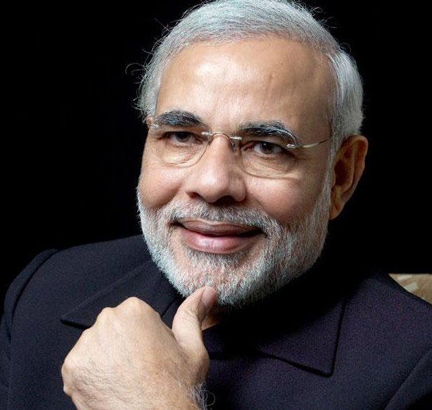
Government Purchase
Expenditure
Salary to employees….Yes
FCI grain purchase = yes
Food coupon, LPG-DBT = no. That money gets counted in “Private consumption”.
Transfer Payments…..No [DBT, Pension, Scholarship, food coupons etc.]

Slide 32
Consumption Private
Government
Foreign Expenditure
Investment

Slide 33

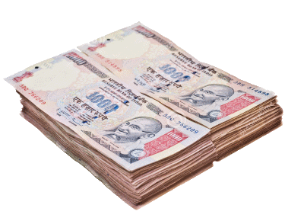
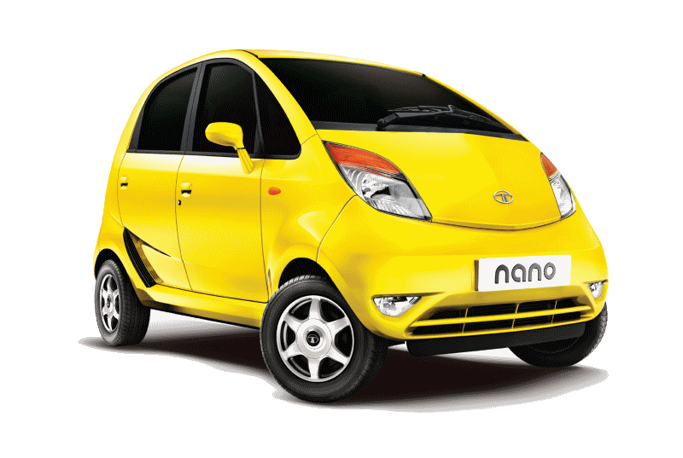
GDP bottom line: “Domestically Produced”
Money earned from “EXPORT”
(+++)
“Domestically produced car”

Slide 34

“Domestically” produced goods/services
Foreign car import
Not our “Domestically” produced car
Private “Final” Expenditure
(+++)
Therefore “Import”
(- - - MINUS)

Slide 35
GDP= C + I + G + (X – M)
+Consumption (Final)
+Government “Purchase”
Foreign Expenditure
(Export-Import)
+Investment

Slide 36
GDP Calculation: THREE Methods
Income Method (WIPR0)
W+I+P+R
Wages, interest, profit, rent
Expenditure
C + I + G + (X – M)
Consumption, investment, Govt. purchase, Net export
Production: Gross Value Added (GVA)

Slide 37

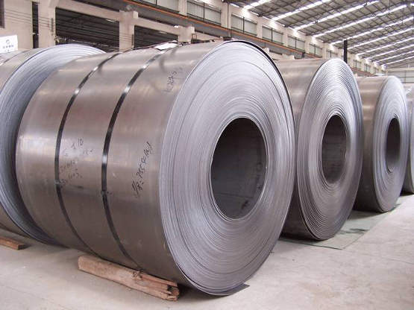
Intermediate Goods
00
Rs.1 Lakh
Rs.5 Lakh
Labor
Capital
Entrep.
Land
Wage(W)
Interest(I)
Profit(P)
Rent(R)
Wage(W)
Interest(I)
Profit(P)
Rent(R)
Wage(W)
Interest(I)
Profit(P)
Rent(R)
5 Lakh
10 Lakh
GDP
10 lakh
Value Added
Rs.1 Lakh
4 Lakh
5 Lakh

Slide 38
16 Lakh
SALE Value
Rs.1 Lakh
5 Lakh
10 Lakh
Cost
Intermed.
Goods
00
1 lakh
5 lakh
6 lakh
GDP
Factor Cost
Gross
Value Added
16-6
=10 lakh

Slide 39
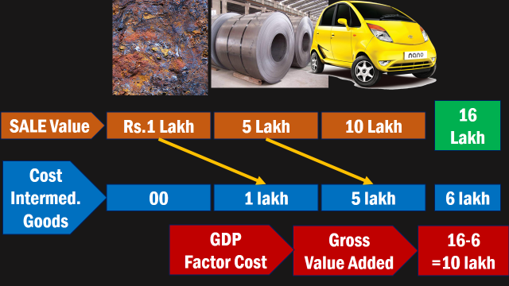
GDP @FACTOR COST
GDP Market Price (MP)

Slide 40
GDP Calculation: THREE Methods
Income Method (WIPR0)
W+I+P+R
Wages, interest, profit, rent
Expenditure
C + I + G + (X – M)
Consumption, investment, Govt. purchase, Net export
Production: Gross Value Added (GVA)
Total Value of Sale – Cost of intermediate goods

Slide 41
GDP doesn’t cover following:
Underground Economy
Non-Marketed Activities
Barter Exchanges
-ve Externality
Income Inequality
Opportunity cost

Slide 42

Gini-Coefficient
H.D.I
In future Economic survey lectures on HRD

Slide 43
So far
Formulas
Calculation Methods
CSO modification
Survey Data

Slide 44
CSO calculating since 1955
Primary
Agriculture
Forestry
Fishing
Mining
Secondary
Manufacturing
Power
Gas-Water
Tertiary
Transport
Communication
Trade
Banking
Insurance
Computer
Public Administration
Defense

Slide 45
CSO utilizes data from following
Goods
ASI
IIP
Economic census
NSSO Surveys
Services
CBDT
CBEC
CPI-Indexes

Slide 46
Until now CSO’ GDP Calculation: FACTOR COST
Income Method (WIPR0)
W+I+P+R
Wages, interest, profit, rent
Expenditure
C + I + G + (X – M)
Consumption, investment, Govt. purchase, Net export
Production: Gross Value Added (GVA)
Total Value of Sale – Cost of intermediate goods

Slide 47
Intermediate Goods
00
Rs.1 Lakh
Rs.5 Lakh
Labor
Capital
Entrep.
Land
Wage(W)
Interest(I)
Profit(P)
Rent(R)
Wage(W)
Interest(I)
Profit(P)
Rent(R)
Wage(W)
Interest(I)
Profit(P)
Rent(R)
GDP
Income method
Rs.1 Lakh
5 Lakh
10 Lakh
Value Added
GDP
Production
4 Lakh

Slide 48
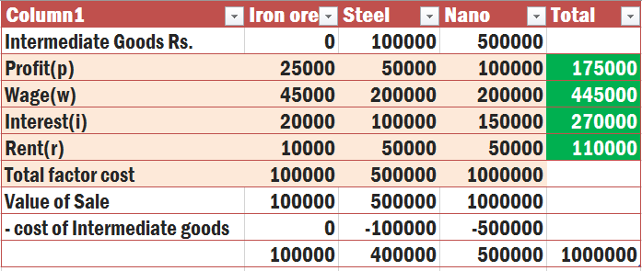
GDP Production

Slide 49

BEFORE
Wages
Profit
Interest
Rent

Slide 50
BEFORE
CSO-2015 Reform
Wages
Profit
Interest
Rent
Compensation
Mixed income / Operating Surplus
Consumption of Fixed Capital

Slide 51


WAGES
Compensation
Only salary
Salaries
+ Social security contribution by Boss (employer) to Employee

Slide 52


Profit
Mixed income / OS
Only workers / laborers get wages
Entrepreneurs get “profit”
What about informal, unorganized family owned Agro, cottage industry? WAGE / PROFIT?
Hence the concept of Mixed income (MI)/ operating surplus (OS)

Slide 53

Profit
Operating Surplus
Corporates – easy to calculate profit
But unorganized firms: difficult to separate profit from wages due to lack of standard accounting
Profit….yes
Mixed income or operating surplus as and where applicable

Slide 54
BEFORE
CSO-2015 Reform
Wages
Profit
Interest
Rent
Compensation
Mixed income / Operating Surplus
Consumption of Fixed Capital

Slide 55

Consumption of fixed capital
CSO revised
System of National Accounts (SNA)
Collaboration among UN, World bank, IMF, OECD and European commission.
if capital asset not “used” => “intermediate goods”
Begin production =>“final goods” generated. Calculate CFC accordingly.

Slide 56
Compensation
Mixed income / Operating Surplus
Consumption of Fixed Capital
GDP GVA at factor cost

Slide 57
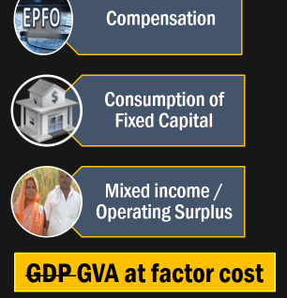
Production
Taxes
Production
Subsidies
GDP GVA at Basic Price

Slide 58
production Taxes
Production Subsidies
Independent of Production Volume
Stamp Duty
Land revenue
Professional Tax
Independent of production volume
Subsidies to Railways
Input subsidies to Farmers, small industries
Administrative subsidies to cooperatives & corporates

Slide 59
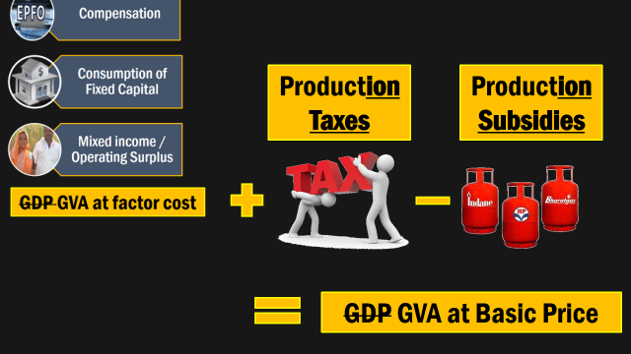
Sum of
GVA @Basic prices
Product
Taxes
Product
Subsidies
GDP at Market Price(MP)

Slide 60

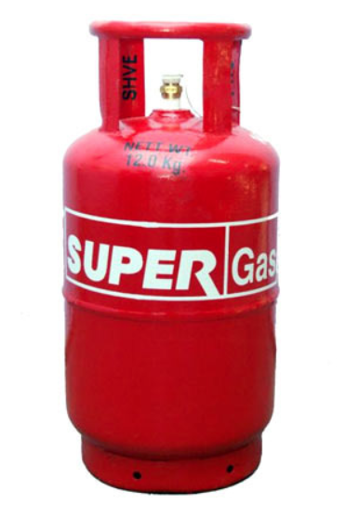
Product Taxes
Product Subsidies
Per unit of production
VAT, EXCISE, Custom, Service Tax
Per unit of Production
Food, Petroleum, Fertilizer
Interest subvention to farmers
Subsidies for insurance to households

Slide 61
GDP at Constant MP
Official GDP of India
Adjust for inflation
Sum of
GVA @Basic prices
Product
Taxes
Product
Subsidies
GDP at Market Price(MP)

Slide 62
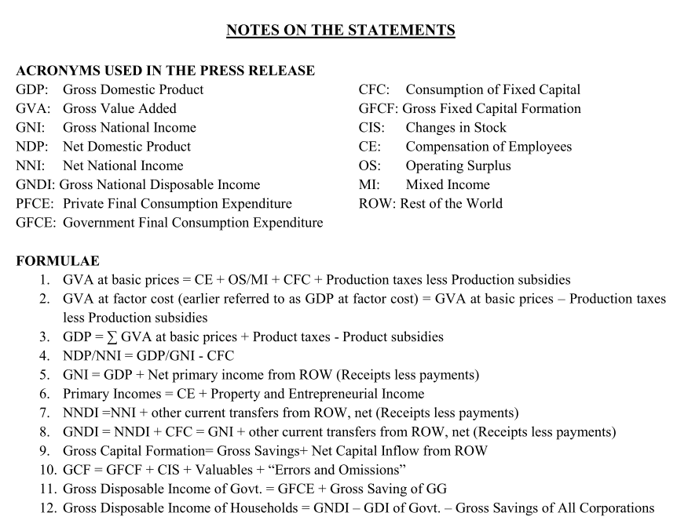
Formulas: Official press release (30th January 2015)

Slide 63

Reforms done
CSO-GDP
GDP @Factor cost….nope
GDP @(Constant) Market price= India’s GDP
Base year: 2004 => 2011
internationally valid System of National Accounts (SNA) 2008
Classified economic activities & their account keeping according.

Slide 64
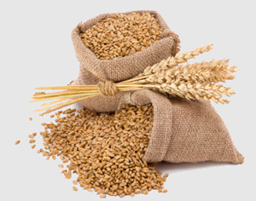
Agro Coverage
CSO-GDP
Agro census 2010 included
Livestock census 2012 included
Meat yield and by-product valuation revised
Crop and livestock activities are segregated

Slide 65
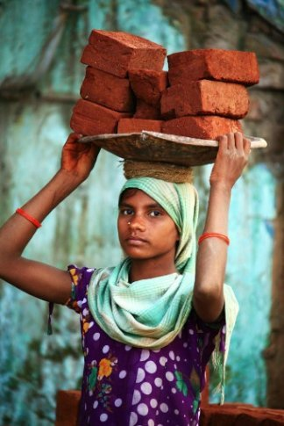
Rural Coverage
CSO-GDP
Local bodies – effective coverage of their services
Informal sector: Latest NSSO survey data included
“Effective Labour Input Method” to get data from rural activities without modern accounting system.

Slide 66
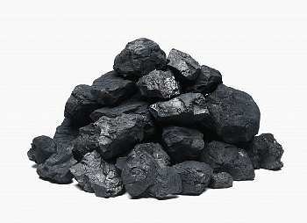
Mining/Mfg Coverage
CSO-GDP
Sand extraction measurement updated
Before: Establishment approach= “production cost”.
After: “Enterprise approach”= production cost + cost of selling and marketing.
Construction sector accounting updated.
Notes:
Estimation of value addition from extraction of sand through an indirect method, in accordance with its use in construction;
- “Enterprise Approach‟ adopted for mining and manufacturing activity using the MCA21 database to account for head offices, ancillary activities, etc. not covered under the “establishment approach‟

Slide 67

Corporates Coverage
CSO-GDP
Before: ASI & IIP data but “Sampling method” = not “complete” picture.
After: Companies’ Mfg. and service production from Corporate affairs MCA21 online database.
“production data” of Financial services (share brokers, NBFCs etc.) with help of SEBI, PFRDA, IRDA

Slide 68
Services Coverage
CSO-GDP
Will use service tax collection rates to find growth in health, education etc.
Before: Earlier CPI AL, RL, IW data used.
After: Now just CPI (Rural urban combined)

Slide 69
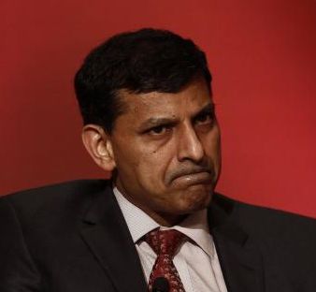
CSO revised method
Criticism
GDP deflator= nominal / real
Real = Nominal / Deflator
Real ∝ 1/deflator
▼ Deflator = Real GDP ▲
2013: Indian economy wasn’t “Rollicking” - Rajanbhai

Slide 70

CSO revised method
Criticism
2014 rate (7.4%) : plausible, due to reforms & investor confidence (in Modi raj)
2013 rate (6.9%) : difficult to believe. Discrepancies with other numbers.
Mfg. growth doesn’t match with ground realities.

Slide 71
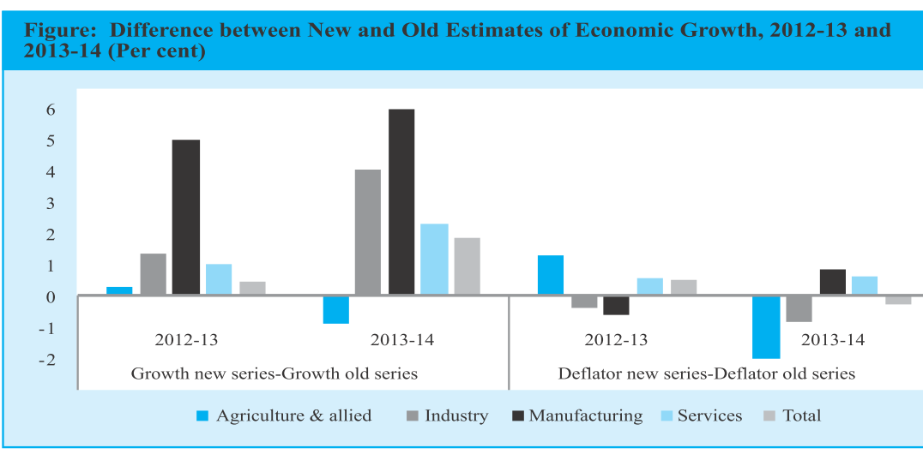
Economic Survey Vol1, Ch1
Mfg. unbelievable

Slide 72
2013 growth unbelievable!
Criticism
Bcoz, Lot Capital flown out due to Fed Tapering.
import bill and CAD high
Domestic savings down, stalled projects and NPAs.
GDP revision usually lowers the numbers- As it happened in other nations.
But India- curiously improved

Slide 73
Economic Survey Vol1, Ch1
Criticism
Need to examine data in greater details
Indian Economy surging…NOPE.
Indian Economy recovering…YES.
Survey forecast for 2015: 8.1-8.5%

Slide 74


Positive
Negative
Earlier Base year 2004
But afterwards 2007-08 subprime crisis. So dramatic changes in prices & economic activities
Must change base year.
New base year 2011
But it wasn’t out from ‘global meltdown’ yet.
Ideal base year should be free from global economic abnormalities, floods, famines, wars etc.

Slide 75

Positive
Negative
Before: ASI- IIP data only “Sample method”
After: Corporate / Mfg. sector comprehensive coverage through MCA21 portal.
But do MSME have enough IT-infrastructure?
Difficult to compare with old data

Slide 76
Impact of GDP calculation method revision?
FRBM Act: Fiscal deficit (FD) as 3% of GDP
▲ GDP = FD “legal compliance” easier
4/100=4% => 3/100= 3%
4/100=4% => 4/130= ~3%
▲ Sovereign credit rating (~BBB borderline. Just one step above “junk status”)
▲ Foreign investment

Slide 77
IMF angle
CSO-GDP
IMF quota depends on Size of Economy and openness of economy
India 2.1 Trillion$ Economy (2014, as per CSO’s new method)
+ Make in India, FDI relax, Ease of doing biz.
India can claim bigger quota @IMF
Although quota reforms require voting

Slide 78
So far
Formulas
Calculation Methods
CSO modification
Survey Data

Slide 79
Number: @constant market prices
Year
2011
2012
GDP (Crores)
8832012
9280803

Slide 80
Growth rate
5.1%
00
Growth (%)
9280803
8832012
GDP (Crores)
2012
2011
Year

Slide 81
Growth rate adjusted for Constant prices
Year
2011
2012
2013
2014
GDP (Crores)
8832012
9280803
9921106
10656925
Growth
00
5.1%
6.9%
7.4%

Slide 82
??
10656925
GDP (constant, Real, inflation adjusted)
2015
2014
Year
GDP (nominal, inflation not adjusted, current)
126,53,762
141,08,945
Nominal
growth rate: 11.5%
Survey predicts:
8.1 to 8.5%

Slide 83
Growth Rate: Base year 2004 vs 2011

Slide 84
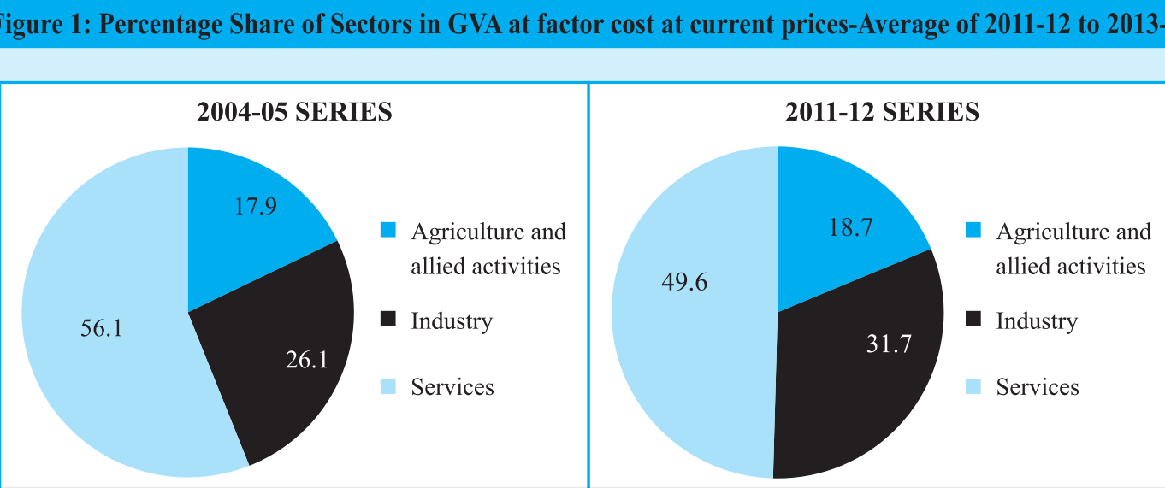
Sectorial contribution (ABSOLUTE CRORES)
“Establishment” approach
Some mfg types under “services”
Enterprise approach: some “services” items now classified as “mfg. industry”

Slide 85
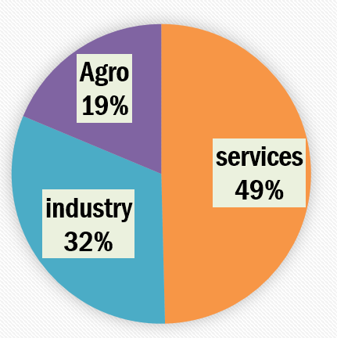
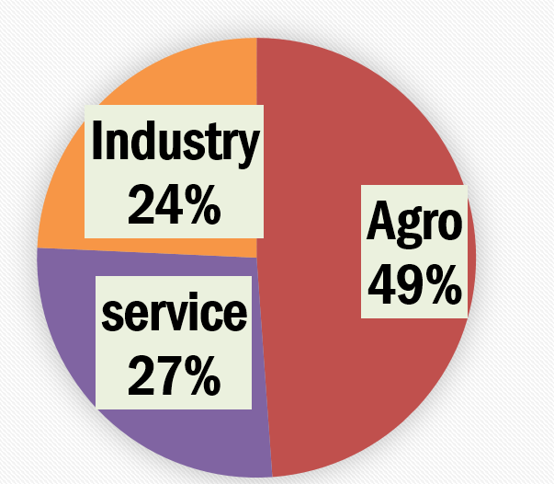


GDP Share (2011-13)
Employment Share (‘11)

Slide 86

GDP Share (2011-13 average)

Slide 87


Employment share (2011)

Slide 88
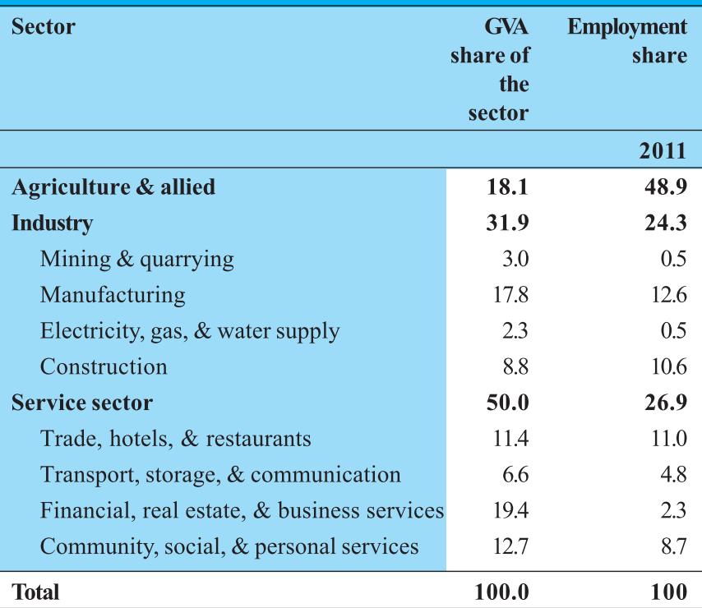
Economic Survey vol2: Chapter 1, page 11

Slide 89


Sector’s “own” growth rate (%) GVA
100 kg.
2013
101 kg.
2014
Agri Growth rate: 1%

Slide 90

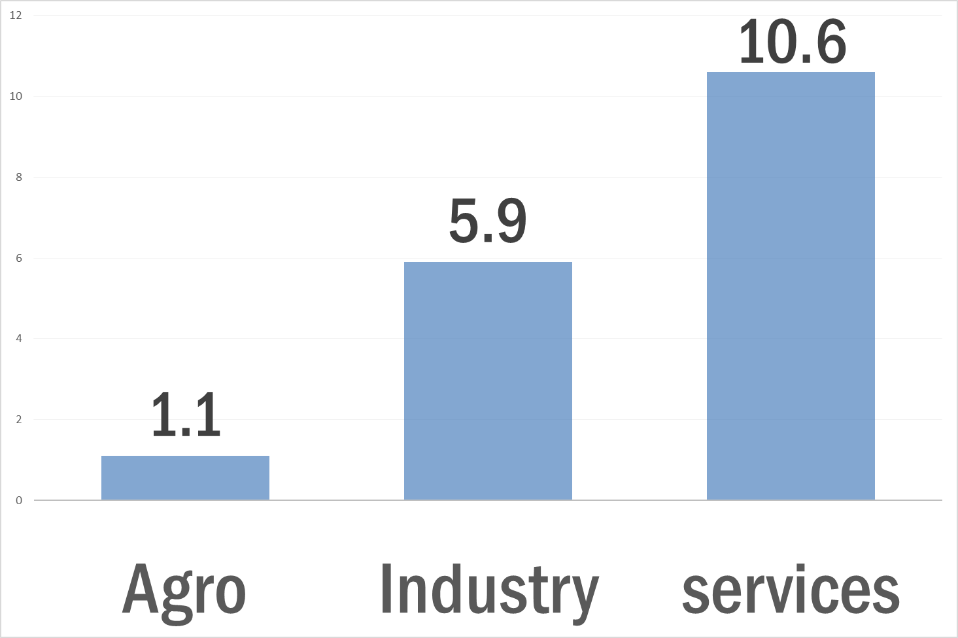
GVA growth rate (2014)

Slide 91
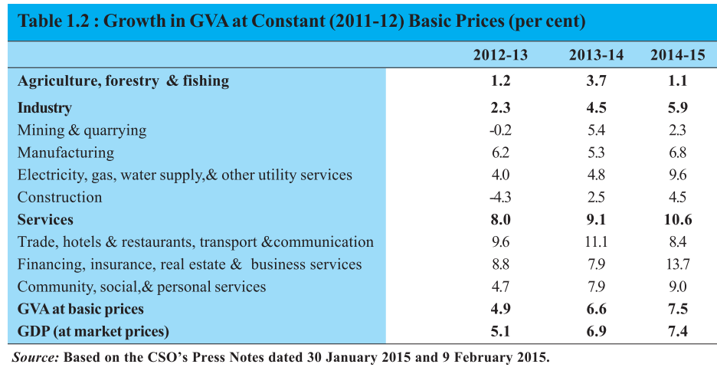
Growth rate: GVA

Slide 92
So far
Formulas
Calculation Methods
CSO modification
Survey Data

Slide 93
Budget Taxation
14th FC
GST
GDP
NEXT TIME: individual sector- issues, policies, reforms, budget-2015 announcement

Slide 94
GDP basics
GDP three methods of calculation
Sectorial share in GDP and Employment
NEXT TIME:

